Slide 1


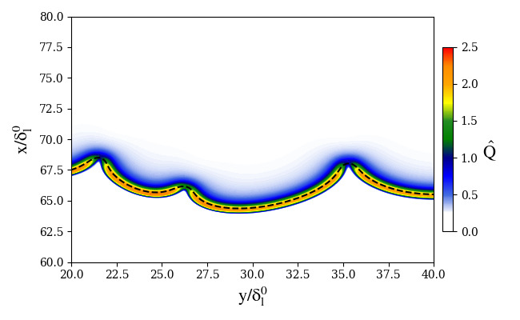
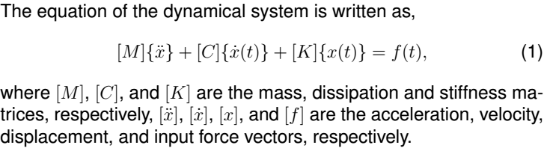

MECSOL2026-XXXX INSTRUCTIONS FOR FORMATTING THE POSTERS OF THE 10th MECSOL 2026
10th ABCM International Symposium on Solid Mechanics, October 19-21, 2026, São José dos Campos, SP, Brazil
First author’s name; second author’s name; ...
INTRODUCTION
Table 1 – Enumerate the figures in the order in which they appear, centered in relation to the text box.
This file must be used as a template for the presentations in the poster sections of MECSOL 2026.
The content must be written in English and printed in poster format (1.2 m high and 0.9 m wide) in Arial font, size 38 and justified, except for the title, author names, emails and subtitles, which must follow the template (as indicated in red).
Example
text | unit | value
Length (Arial 38) | m | 1.5
Obs.: Format the table in two columns if necessary.
MATERIALS AND METHODS
The poster presentation must address the following topics in a concise and objective manner: Introduction, Materials and/or Experimental and/or Numerical Methods, Results and Discussion, and Conclusions. The Acknowledgments and References sections are optional. Authors are responsible for bringing the poster already printed.
Equations can be typed or inserted into the text:
The margins of the text fields must be 25 mm on the left and right and 10 mm on the top and bottom.
Keep a space of 30 mm between the text and the page margins. The width of the text must be 410 mm. (Check the formatting size indicated by the red braces - do not forget to delete them!)
Figure 1 – Enumerate the figures in the order in which they appear, centered in relation to the text box.
CONCLUding REMARKS
conclusion 1,
conclusion 2,
... .
RESULTS AND DISCUSSION
Acknowledgements
The most important results are ideally presented in figures or tables.
This section is optional.
REFERENCES
This section is optional.
Insert the photo of the presenter here
Presenter
Presenter’s name
Occupation/Department/Faculty
University
E-mail address

