Slide 1









INSTRUCTIONS FOR SUBMISSION OF PAPERS IN THE ABCM Series on Mechanical Sciences and Engineering - 12th Brazilian Manufacturing Engineering Congress - COBEF
Promoter:
Organizer:
Partners:

Slide 2
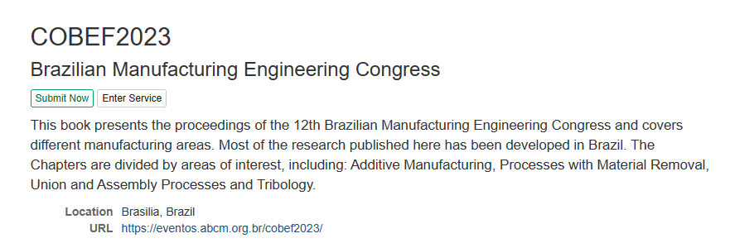
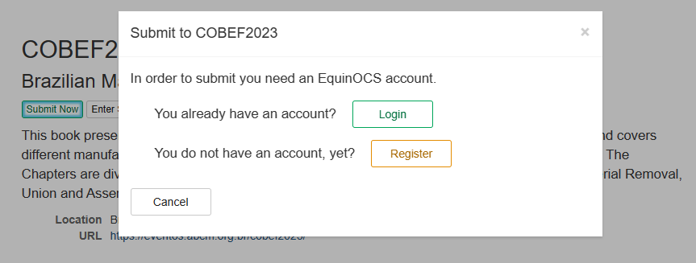
Open the link https://equinocs.springernature.com/service/COBEF2023
Click in “Submit Now”
Register to access the system

Slide 3
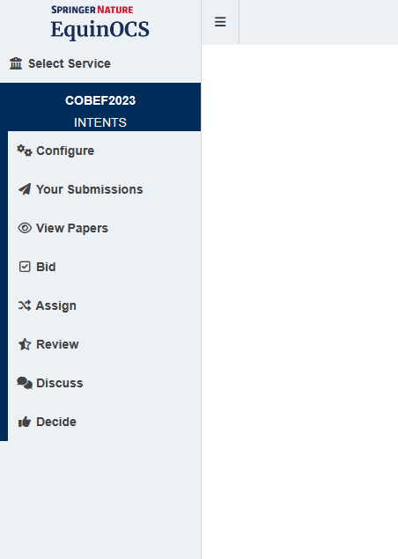
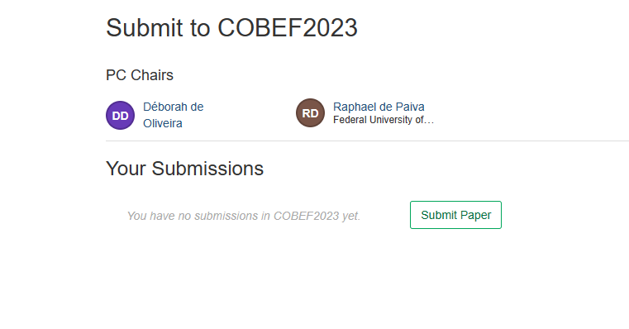
Click on “Your Submissions” in the left panel of the page and then click on “Submit Paper”.

Slide 4
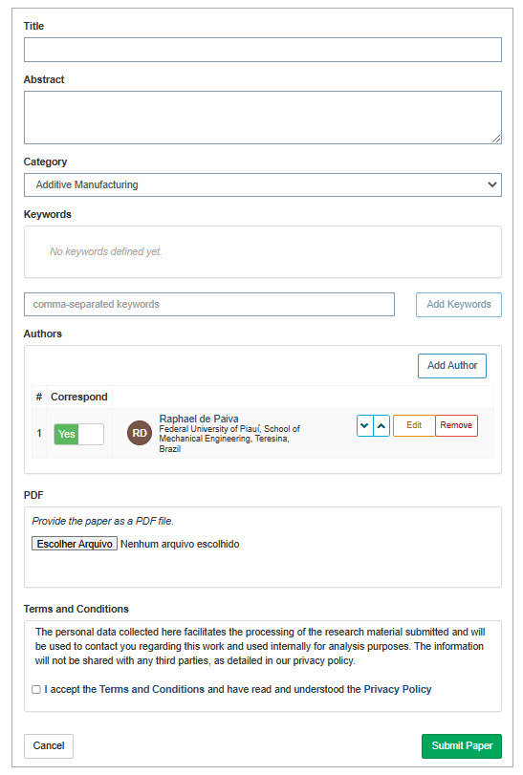
Fill in the paper information correctly, including the thematic area as submitted in the ABCM system (category).
Upload the paper in PDF format. Make sure that the paper is in the correct template, available on the official website of COBEF 2023 (Submissions tab -> Springer Nature).
Attention, the template is different from that one of COBEF2023’s annals.

Slide 5
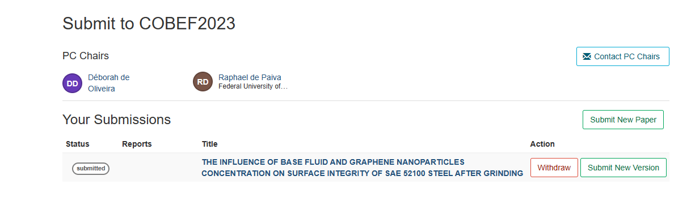
Once the submission is completed, the paper will be listed in “Your Submissions”.
It will undergo further correction before being accepted for the ABCM Series. Stay tuned for notifications and emails.

Slide 6
See more tips at:
https://support.springernature.com/en/support/solutions/articles/6000245512-authors-of-papers-chapters

